Slide 1
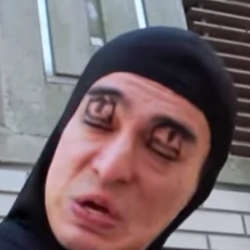
printf(“ChinChin\a”);
Team Members :
Goh Wei Zhe
Irfan Hidayat
Ryan Lim
Lim Chin-Chin Ann

Slide 2



Table of Contents
Introduction
Role of each team members
Game Concept
What our game is about
Use a one-sentence statement, supported by visuals.
Core Features
Central pillar of the game
Primary Mechanics
Scope and Potential Issues
Major Features for final version
Prioritized features for prototypes
Big-picture timeline
Identify risks and mitigations

Slide 3
Roles of Member
Irfan - Producer
Schedule task & meeting for teams, communications with external
Chin Ann - Designer & Artist
Design elements, levels of game, game logic
Ryan - Programmer
Implement game logic, solve implementation problems
Wei Zhe - Musician
Sound effect and music

Slide 4
Game: Prison Break
One sentence statement:
Prison break is a top down action game where the players scurries through the level by only sprinting short distances.
What makes our game special/unique selling point?
Distance is controlled by how long the spacebar is pressed
Stealth as you avoid the enemies

Slide 5
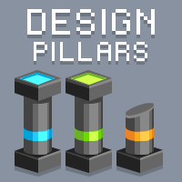
Core Features
Game Pillars:
Top down
Time based Movement
Map traversal
Mechanics:
Instant death
Scoring System
Enemies & Obstacles
Movement; hold space to determine distance and direction
Able to go back and forth between levels to clear goals

Slide 6
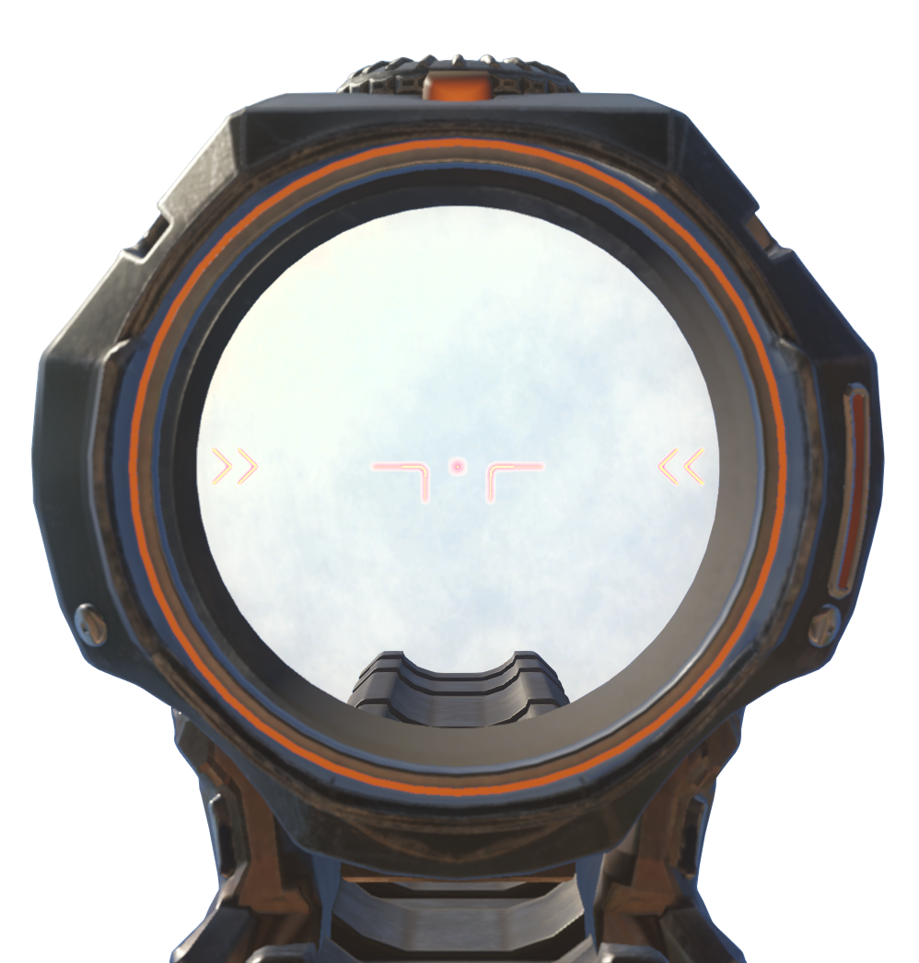
Scope and Prioritize Features
Scope:
10 levels;
Introduce more mechanics.
Increasing difficulty.
Challenging Maps
Major features for final version:
Multiple enemies
Complex obstacles
Unique movement
Score system
Prioritized feature for prototypes:
Movement; hold space to determine distance and direction
Set pathing enemy + death
Goal

Slide 7
Big Picture Timeline
Week 9 (1st week) | Prototype Game state
Week 10 (2nd week) | New mechanics 3 new levels
Week 11 (3rd week) | New Enemy type New mechanic 3 new levels
Week 12 (4th week) | 4 new levels
Week 13 (5th week) | QA testing. Debugging
Week 14 (6th week) | Final touch up

Slide 8
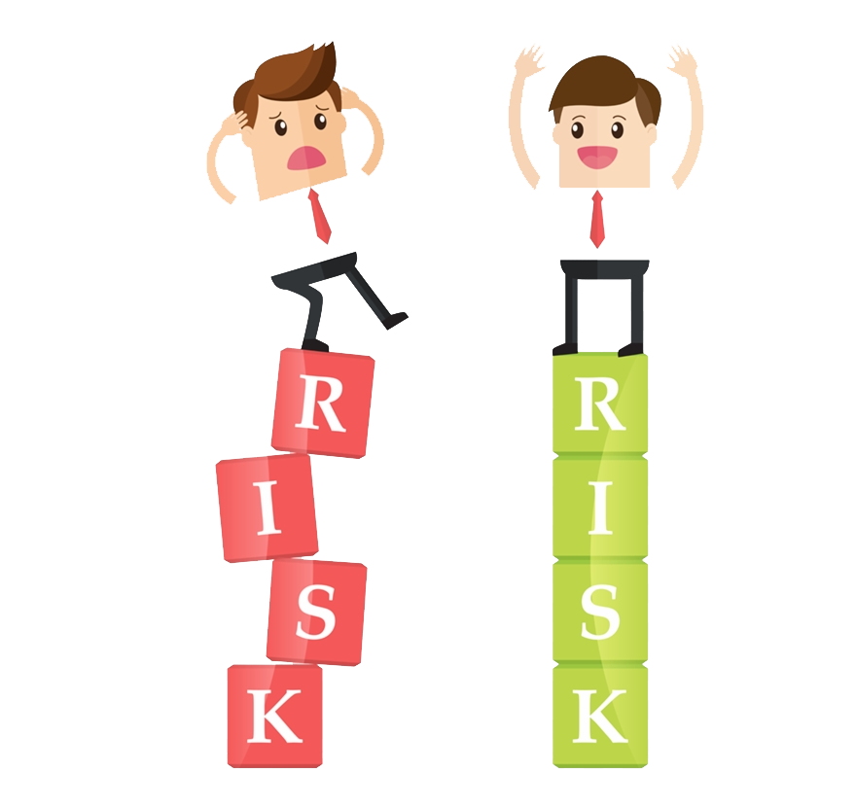
Risks and mitigations
Risk:
Coding the AI and movement may take longer than expected .
Game might end up too easy if the puzzle is not crafted well
Mitiations:
Helping each other out despite of the roles we take.

